Slide 1

Project 2
Evan Sadasivan, Avinash Patel and Christine Nashashibi
Notes:
Title Slide
Include the name of the project and group members.

Slide 2


Motivation & Summary
Despite the recent downward trend in crypto currencies and stable coins within the previous six months, they continue to be an integral digital currency and form of investment.
Notes:
Motivation & Summary Slide
Define the core message or hypothesis of your project.

Slide 3



We developed ML models using three Python Libraries
Scikit Learn
Evaluated the model using mean squared error, and examined the data by looking at the R Squared score
Keras.Tensorflow
Used LSTM (Long Short Term Memory), which is a type of Recurrent Neural Network
auto_ts
Auto Time Series analysis. Best model determined by RMSE or NRMSE.

Slide 4

Data Cleanup
We gathered historical data on three cryptos and four stable coins using API Dojo
We combined the past three years of data into a single DF for each
We cleaned the data by dropping nulls, adding datetime index, and converting numbers written as strings (e.gs. 1mil, 2k) to floats
We dropped extraneous info keeping only our target, 'close' and the features we would use for our models: open, high, low, and volume.

Slide 5

Scikit Learn
Train model to predict ‘future’ close prices for btc, eth, and luna
Evaluate each model’s competence using means squared error

Slide 6
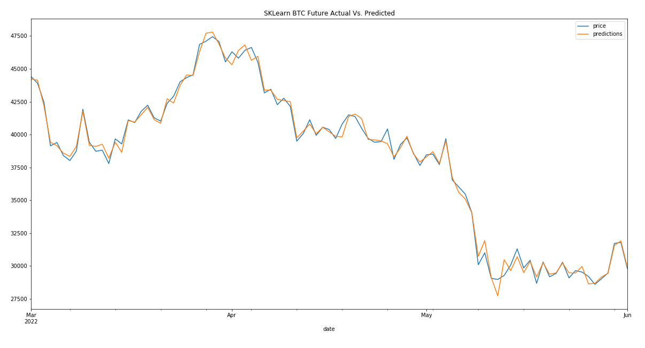
BTC
90 days
predicted
171788 Mean
Squared Error
0.994547
R Squared
Score

Slide 7
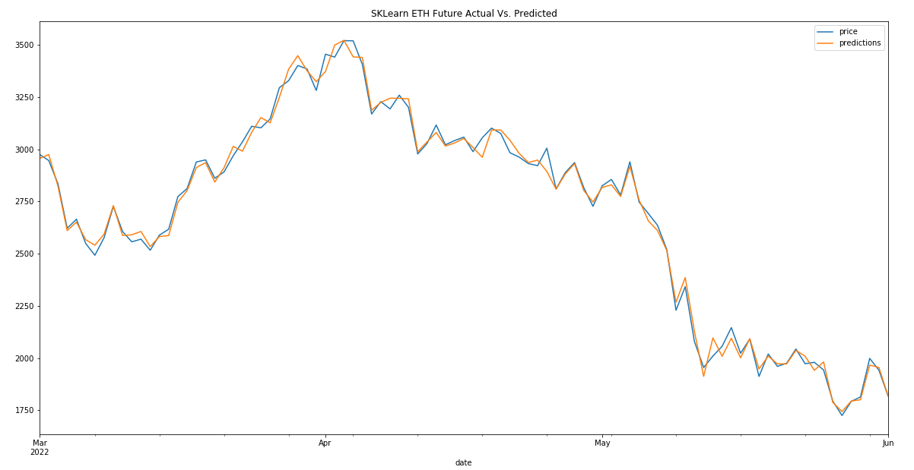
ETH
90 days
predicted
1187 Mean
Squared Error
0.995021
R Squared
Score

Slide 8
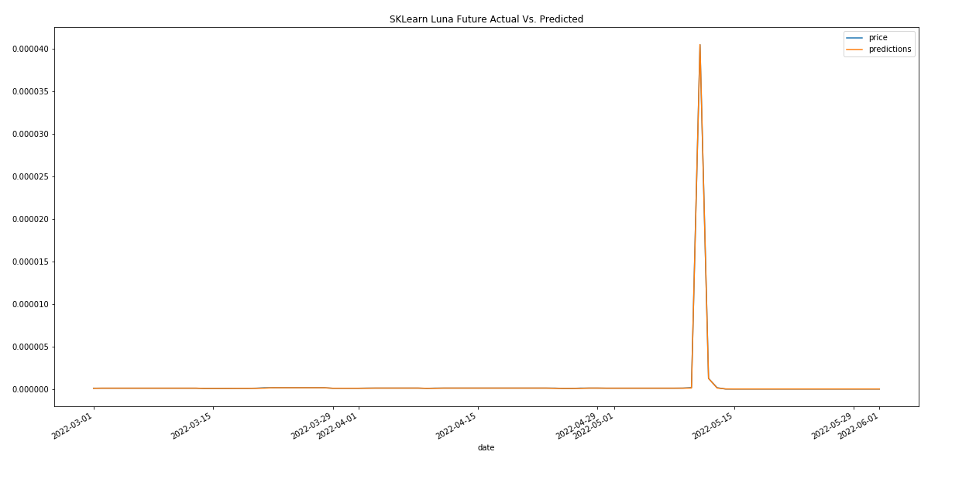
LUNA
90 days
predicted
1.29279 Mean
Squared Error
0.99999
R Squared
Score

Slide 9

Keras TensorFlow

Slide 10
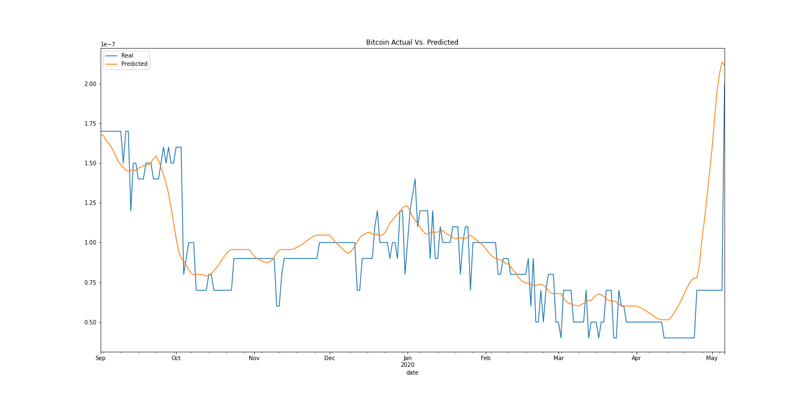
Notes:
Loss 0.007

Slide 11
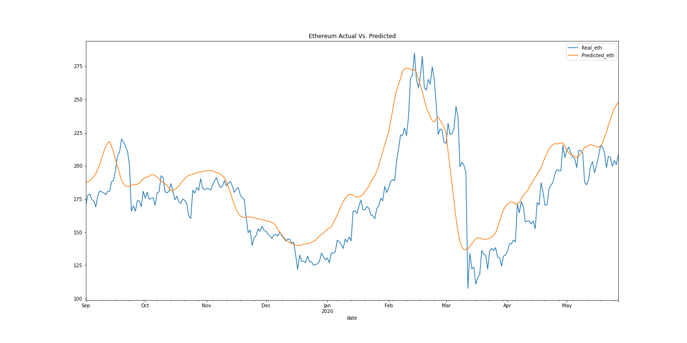
Notes:
Loss 2.8040

Slide 12
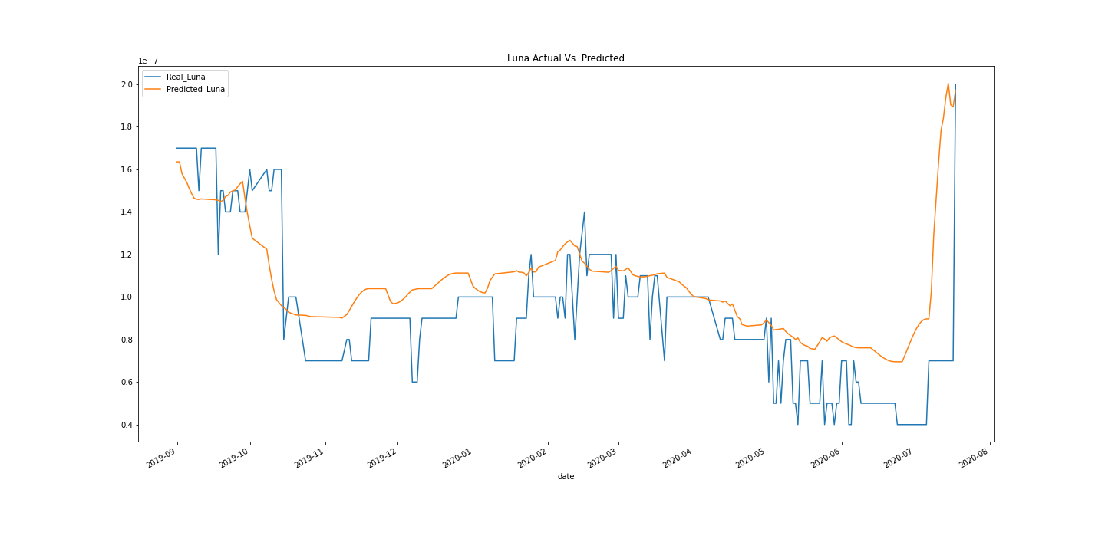

Slide 13

Stable Coins
Remember we are looking for stability.
Unlike stocks and crypto currencies we do not hope we see great fluctuations here.

Slide 14

Auto Times Series - collection of multiple time series models (https://github.com/AutoViML/Auto_TS)
Best model is determined based off of the RMSE (Root Mean Squared Error) or NRMSE.
RMSE is the standard deviation of the residuals (prediction errors). Residuals are a measure of how far from the regression line data points are; RMSE is a measure of how spread out are these residuals.
Some of the models have small RMSE scores (like- 0.000xxx). This could be a cause for concern due to over fitting. Possibly fixed with larger dataset but also keep in mind that we are looking at stable coins who ideally stay near 1.

Slide 15
Augmented Dickey Fuller Test
Determine if data is stationary i.e. does not have a trend nor is affected by seasonality. (mean and variance remain constant)
Lag - differences are used to create stationary data from unstationary. Needed for ARIMA and VAR models.
Determining how many lag-differences are needed to make data stationary .
Results:-
BUSD - required lag-1 difference.
DAI - data is stationary. No lag difference needed.
USDC - required lag-1 difference.
USDT - required lag-1 difference.
Notes:
Augmented Dickey Fuller Test is an updated version to the orginal DFuller test. This test analyzes whether or not a given data series is stationary or not. Stationary data is data that has no trend nor is it affected by seasonality. In stationary data, summary statistics like mean or variance remain constant. In order to make non stationary data stationary we must apply a lag difference. Differencing allows for the removal of series dependence on time i.e. it makes it stationary. In the case of our analysis BUSD, USDC, and USDT all required Lag-1 difference in order to become stationary. Stationary data is necessary for models like VAR and ARIMA.

Slide 16
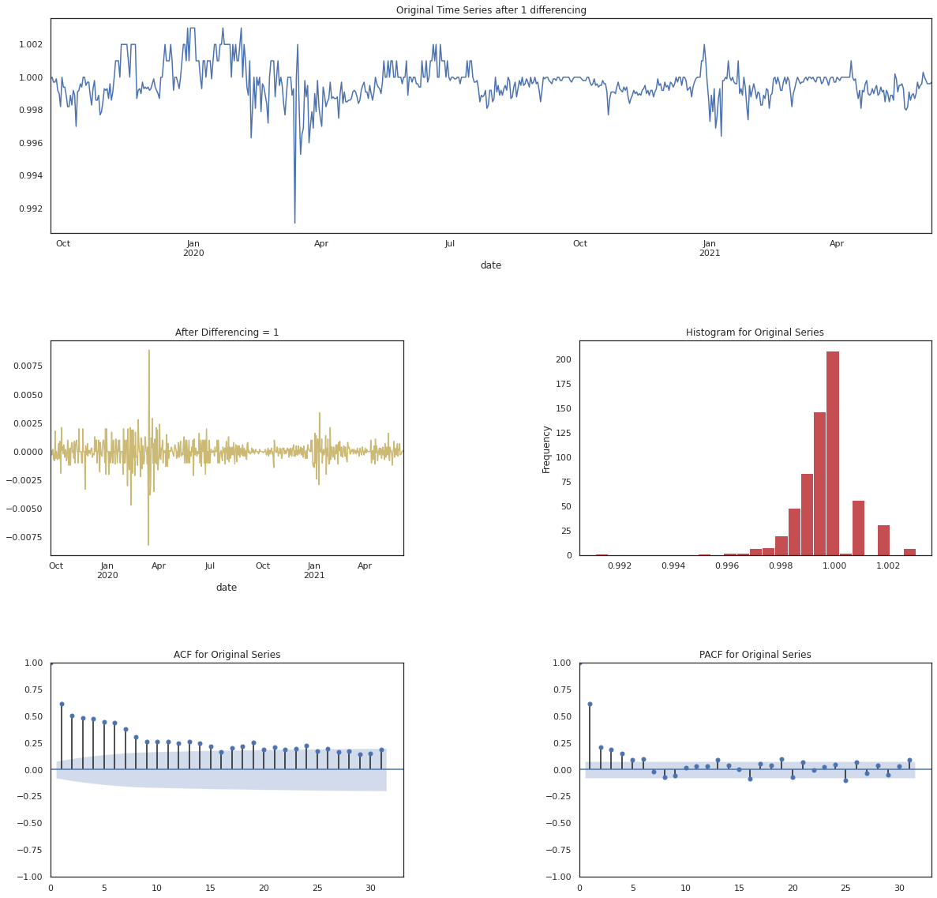
Notes:
BUSD - ADFuller

Slide 17
Vector AutoRegression (VAR)
Vector Autoregression (VAR) is a multivariate forecasting algorithm that is used when two or more time series influence each other.
Vector Auto Regression (VAR) is bi-directional i.e. the variables influence each other.
Seems to be the best model in terms of RMSE for BUSD, USDC, and USDT.
Impulse response functions trace the dynamic impact to a system of a “shock” or change to an input

Slide 18
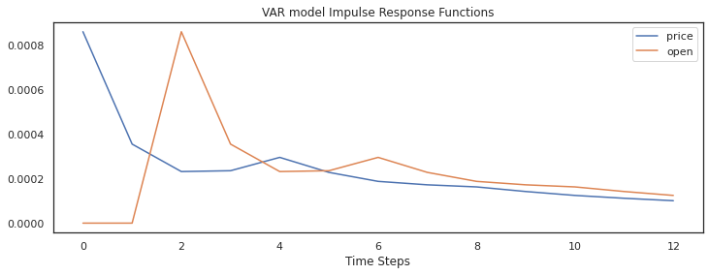
Notes:
BUSD VAR model - Usually, the impulse response functions are interpreted as something like "a one standard deviation shock to x causes significant increases (decreases) in y for m periods (determined by the length of period for which the SE bands are above 0 or below 0 in case of decrease) after which the effect dissipates. The increase peaks in period k." Such interpretation fits well into objectives like 'how x effects y', 'when the maximum impact is experienced', and 'for how long the effect lasts'. These are important pieces of information about the relationships between time series.

Slide 19
Prophet
Model used for time series evaluation and forecasting. It works best with data that has seasonality.
Results for all stable coins show that Prophet fell short to the VAR model in regards to RMSE score.
Only in the DAI stable coin did auto_Sarimax outperform both VAR and Prophet models.

Slide 20
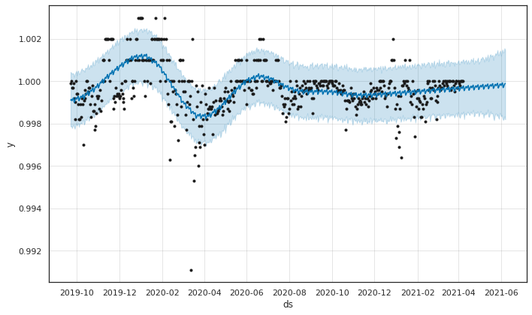
Notes:
BUSD

Slide 21
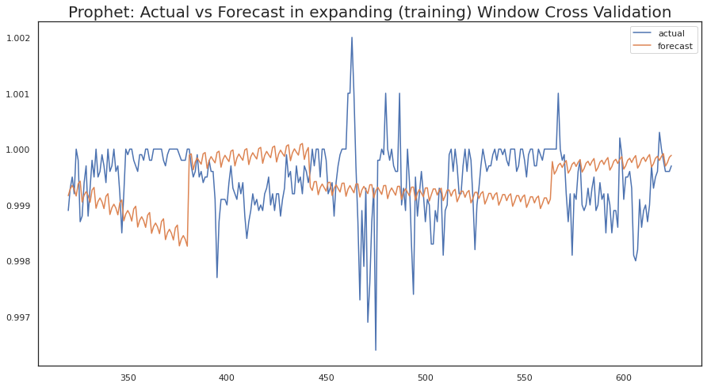
Notes:
BUSD

Slide 22
SARIMAX (Seasonal Auto-Regressive Integrated Moving Average w/ eXogenous factors
ARIMA models prefer stationary data.
SARIMAX is an updated ARIMA model that will take non stationary data.

Slide 23
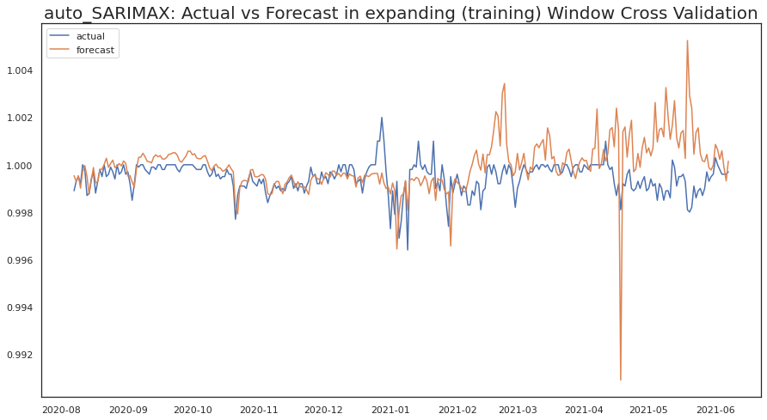
Notes:
BUSD

Slide 24
XGBOOST
XGBoost is a decision-tree-based ensemble Machine Learning algorithm that uses a gradient boosting framework
In all 4 stable coins the XGBOOST RMSE value came back as infinity.
This model will not be a good form analysis for these datasets.

Slide 25
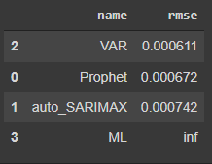
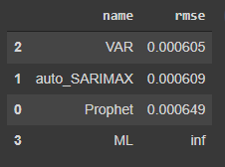
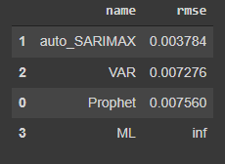
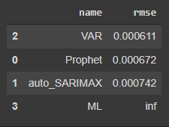
RMSE Scores
BUSD
USDC
DAI
USDT

Slide 26
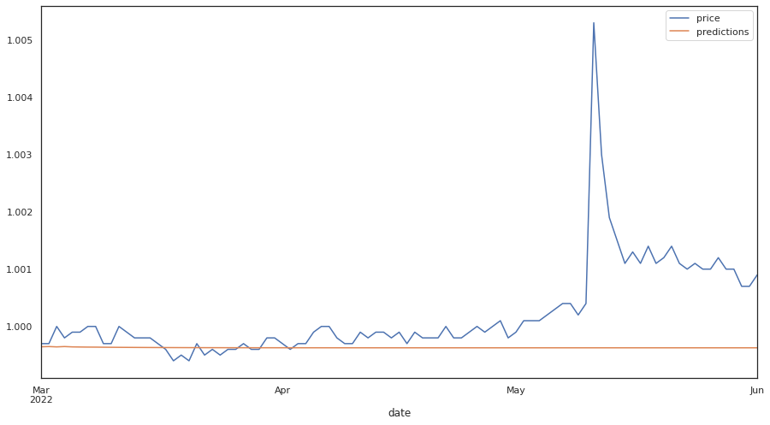
BUSD predictions on new data
Notes:
BUSD, USDC, USDT are only showing minute changes for e.g. 0.95554 to .95559 hence the predictions look to be constant. This may not be ideal but, it does show clear stability of the coin.

Slide 27
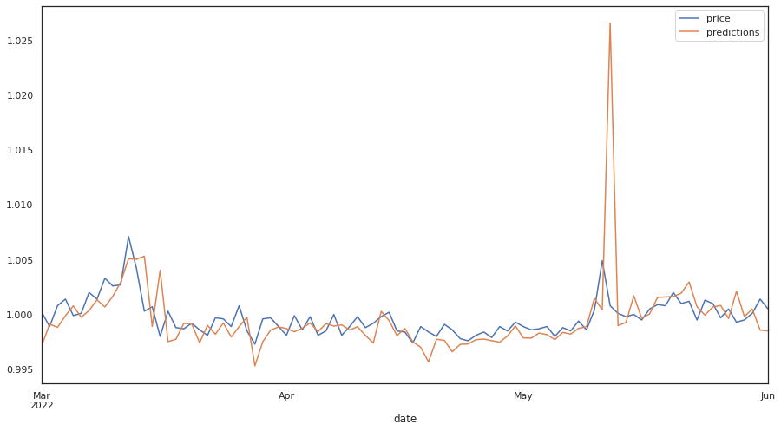
DAI predictions on new data
Notes:
All others remain constant. This could be an issue with model or data itself. Based off of SARIMAX

Slide 28

Questions?
Notes:
End

